Slide 1
Modelling coupling effect between hydrogen diffusion and mechanical behaviour of metals
Presenter: Xuan Binh
Supervisor: Junhe Lian
Department of Mechanical Engineering
Aalto University

Slide 2
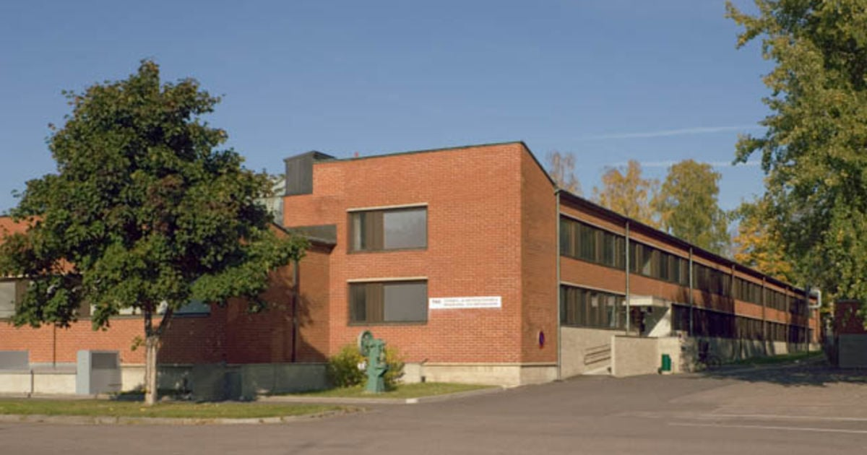
Table of Contents
Introduction
Literature review
Studied materials
Modified Bai-Wierzbicki (mBW)
Physics-informed Neural Networks
Master Thesis Plan
Discussions on planned outcome

Slide 3
Literature review
Title | Authors, Year | Summary/Results | Relevance

Slide 4


Part 1: Pure diffusion

Slide 5
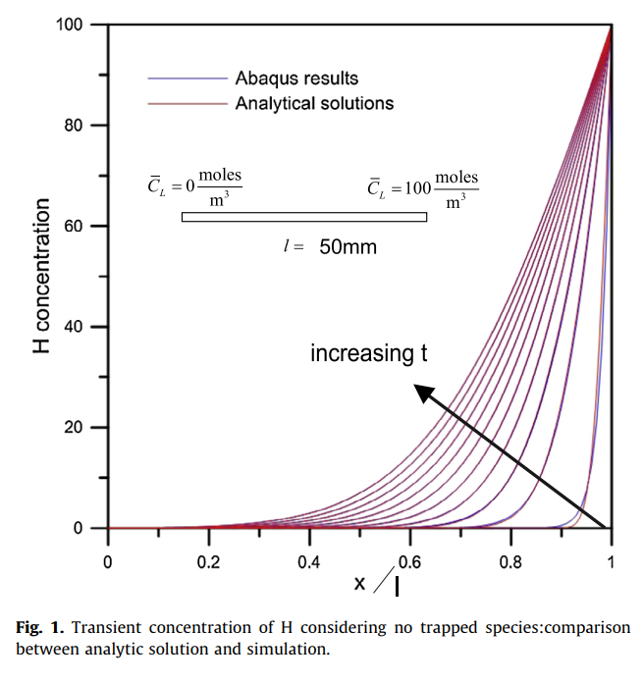
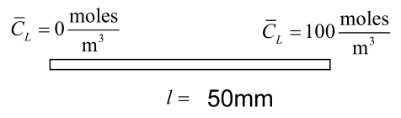
Figures from the paper
Diffusion direction
x = 0
x = l
Position coordinate on the bar is x/l

Slide 6
Reproduced figures

Slide 7
Part 2: Coupled diffusion-mechanics

Slide 8
Part 2.1: Elastic plate with a hole

Slide 9
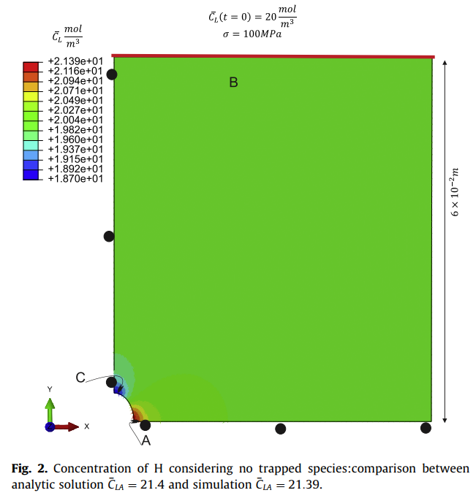
Elastic plate with a hole: Figures from the paper

Slide 10
Elastic plate with a hole: Reproduced figures

Slide 11
Part 2.2: Elastic–plastic plate with a deep notch

Slide 12
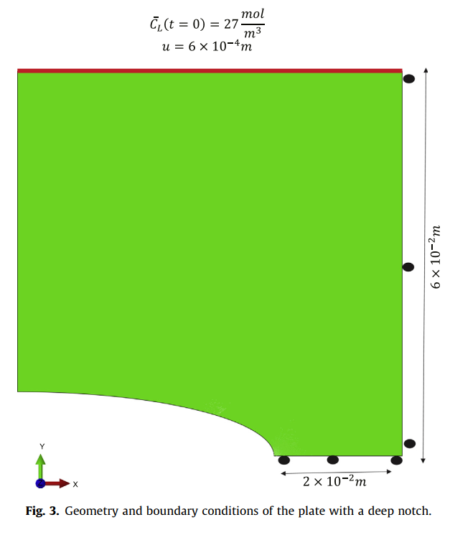
Figures from the paper

Slide 13
Reproduced figures

Slide 14
Master Thesis plan overview
Overall aim: Make hydrogen embrittlement fracture predictable with extension of Bai-Wierzbicki model
First part: macrosocpic HE level
Macroscopic: eMBW + enHill model + HE model => HE aware fracture model under different stress states.
Right now we have results of
1. Hydrogen charged BCC structure of CP1000 steel given by professor Lian
2. Hydrogen charged FCC structure of 316L stainless steel given by Mr. Shengzhao
Second part: machine learning applications
Conduct inverse engineering on Hydrogen concentration in the experiment charging liquid
- There are multiple options to solve this problem => Physics-Informed Neural Networks (PINN) is one of solutions.
Replacing the FEM simulation with ML algorithm (Riddhi’s project)
Third part: microsocpic HE level
In this part, the mission is to couple HE with CP model, must do this in Abaqus. This is still speculative

Slide 15
Gantt Chart
RESEARCH TOPICS |  | 1/03 – 31/03 |  |  |  | 1/04 – 30/04 |  |  |  | 1/05 – 31/05 |  |  |  | 1/06 – 30/06 |  |  |  | 1/07 – 31/07 |  |  |  | 1/08 – 31/08
 |  | 1 | 2 | 3 | 4 | 1 | 2 | 3 | 4 | 1 | 2 | 3 | 4 | 1 | 2 | 3 | 4 | 1 | 2 | 3 | 4 | 1 | 2 | 3 | 4
PART I Macro scopic level HE | Read literatures
 | eMBW + HE model dev
 | Build and test simulation
 | Parameter calibration
PART II ML coupled simulation | PINN for Hydro concentration
 | Fortran coupled ML
PART III Micro scopic level HE (Optional) | HE aware crystal plasticity

Slide 16


